Slide 1

Sneakerz Store Using React.js, Spring Boot and MySQL
Created By:
Aniket S. Jaiswal
Bhagyesh B. Randhawan
Guide By:
“SONALI MA’AM”
Co-ordinated By:
“ROHIT PURANIK SIR”
AND “NARENDRA PAWAR SIR”

Slide 2
CONTENTS
INTRODUCTION
OBJECTIVE
TECHNOLOGY USED
SOFTWARE & HARDWARE CONFIGURATION
DIAGRAMS
DATABASE DESIGNS
DEMO

Slide 3
Introduction
The Sneakerz Store (SS) application enables customers to browse through the shops, and a system administrator to maintain lists of shop categories. Also the developer is designing an online shoes shopping site to manage the items in the shop and also help customers to purchase them online without visiting the shop physically.The Sneakerz Store will use the internet as the sole method for selling goods to its consumers.
This system allows the customer’s to maintain their cart for add or remove the product over the internet based on their availability. Customer will be able to review order history and able to cancel order within 24 hours.

Slide 4
Objective
The main objective of the Online Sneakerz Store is to manage the details of Shoes, Customer, Payment, Delivery, Bills. It manages all the information about Shoes, Cash, Bills, Shoes. The project is totally built at administrative end and thus only the administrator is guaranteed the access. The purpose of the project is to build an application program to reduce the manual work for managing the Shoes, Customer, Cash, Payment. It tracks all the details about the Payment Delivery,Bills.

Slide 5
Technology Used
React as a Front End
React allows developers to create large web applications that can change data, without reloading the page. The main purpose of React is to be fast, scalable, and simple
Java Spring Boot as a Middle Ware
The main goal of the Spring Boot framework is to reduce overall development time and increase efficiency. React has become the first choice for frontend because it gives developers the ability to work with a virtual browser (more friendly than the real browser).
MySQL as a Backend
The main goal of the MySQL is to maintain the database in the form of tables.

Slide 6
Software & Hardware Configuration on Server Side
Windows 11
Ram – 8GB
Disk space- 1TB
Requirements for User(Client Side)
Android version – 10 or later
Active Internet Connection

Slide 7
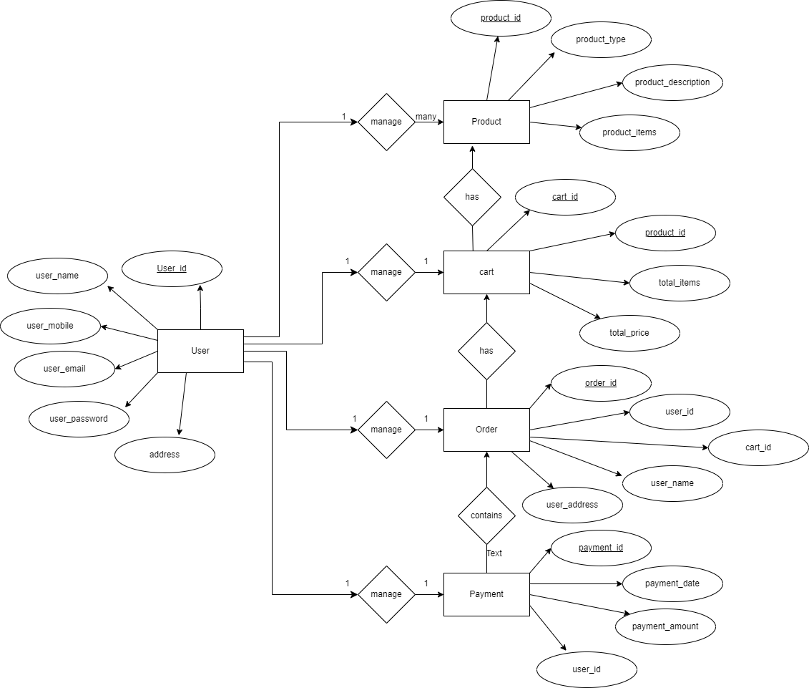
Diagrams
ER Diagram

Slide 8
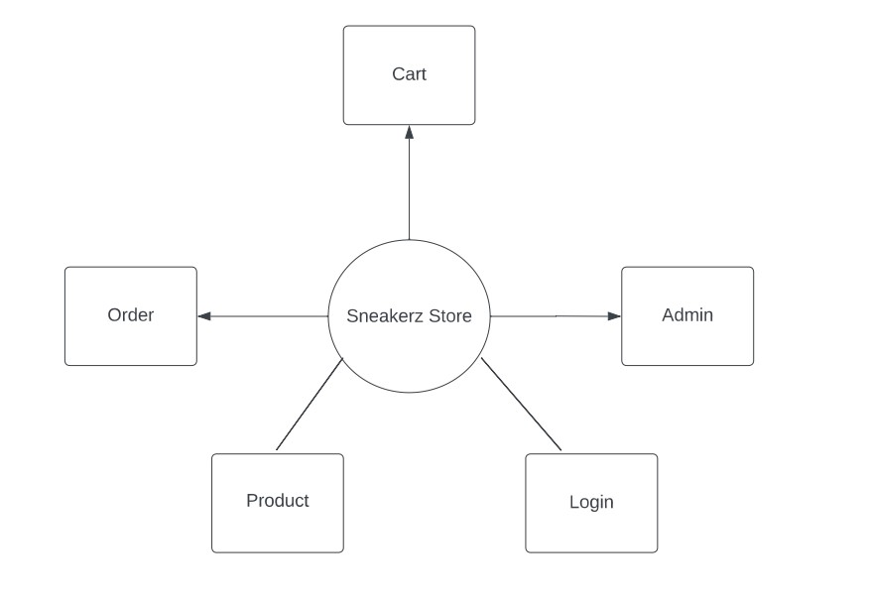
DFD
Oth Level

Slide 9
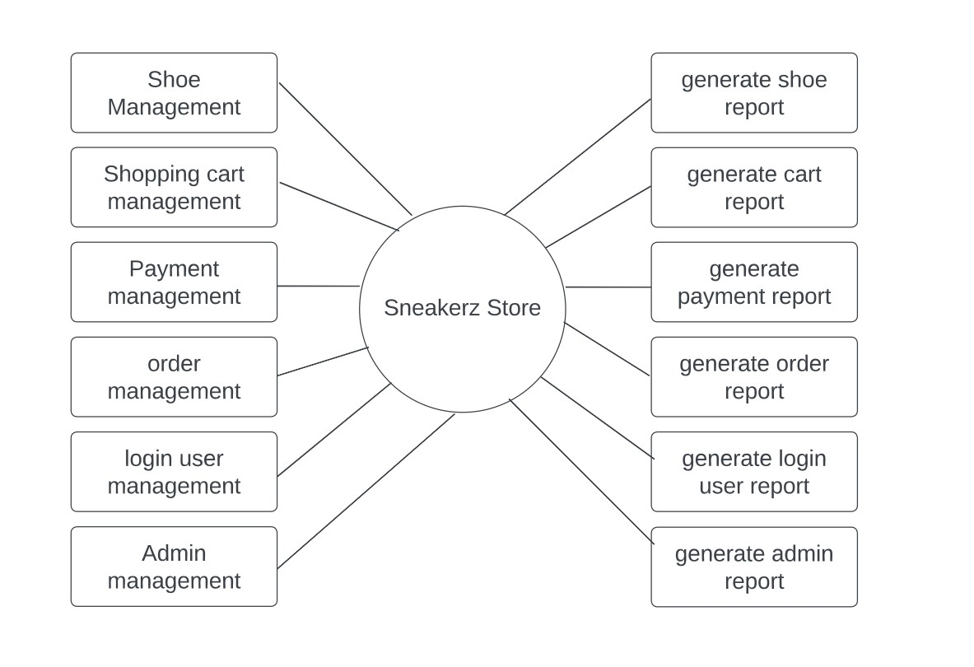
1st level

Slide 10
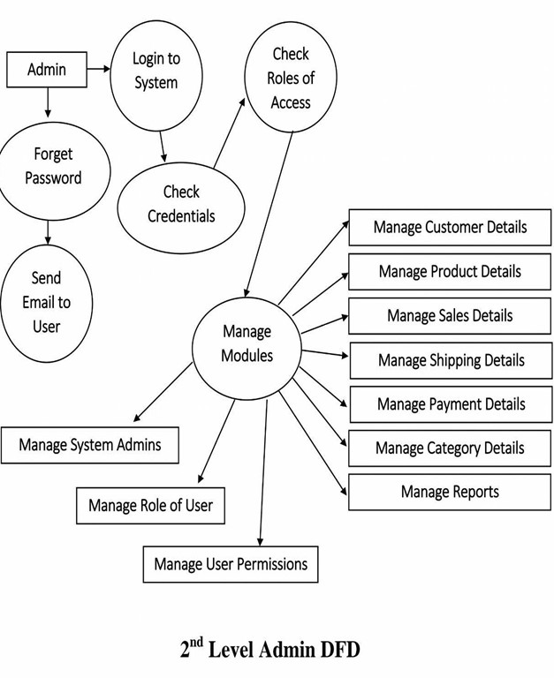
2nd Level

Slide 11
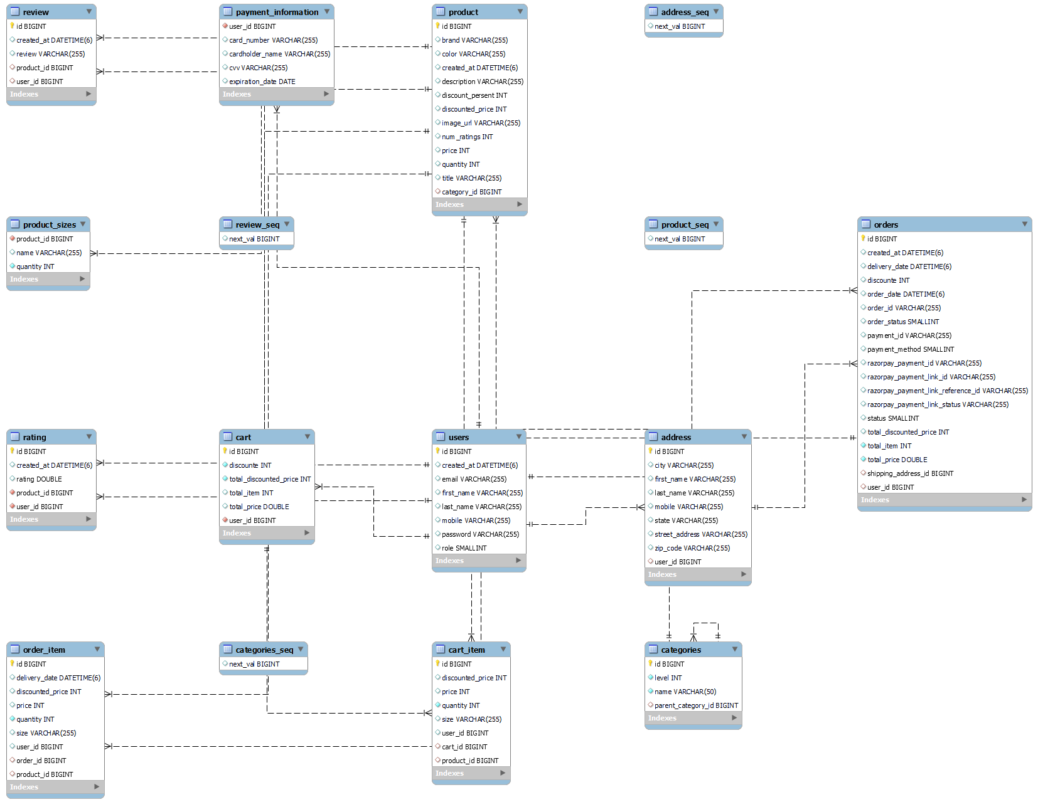
Class Diagram

Slide 12
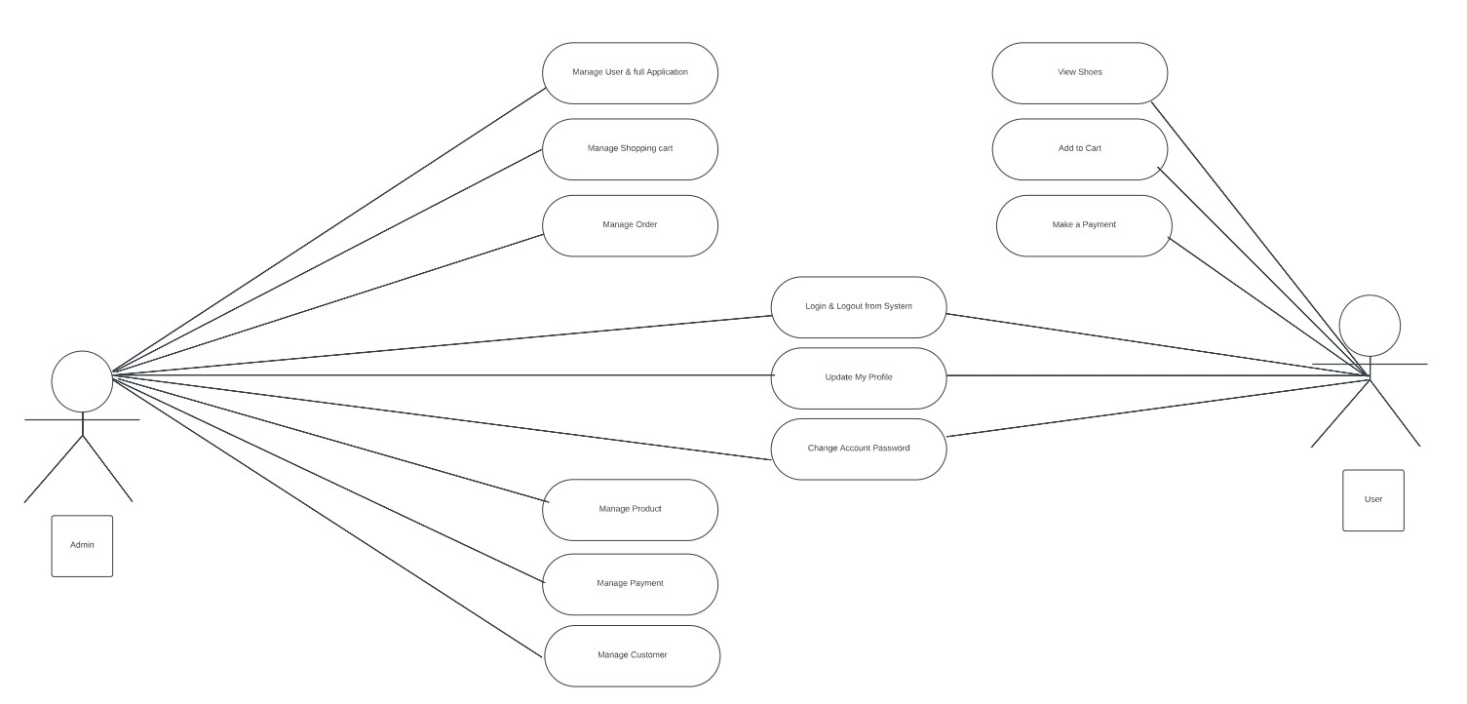
Use Case Daigram

Slide 13
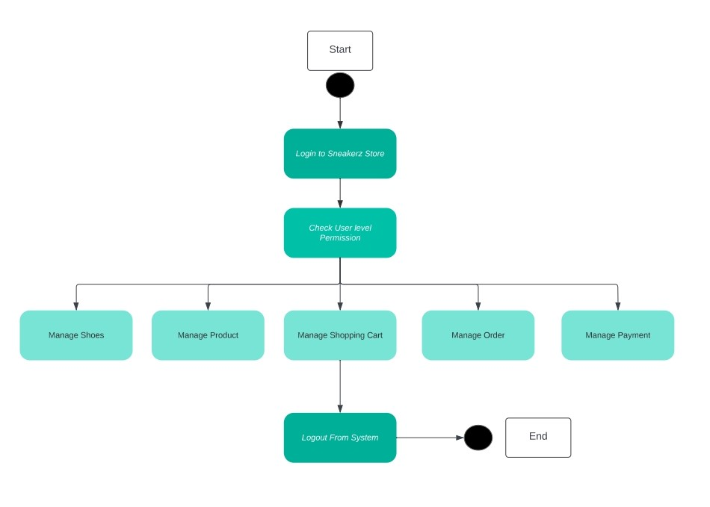
Activity Diagram

Slide 14
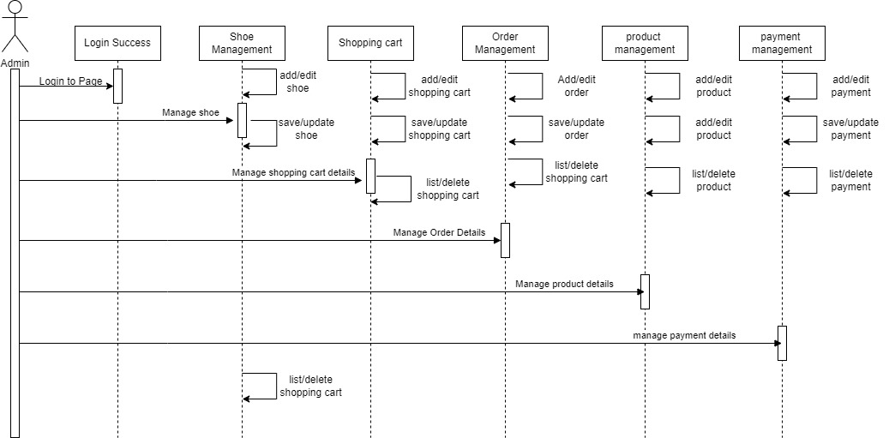
Sequence Diagram

Slide 15
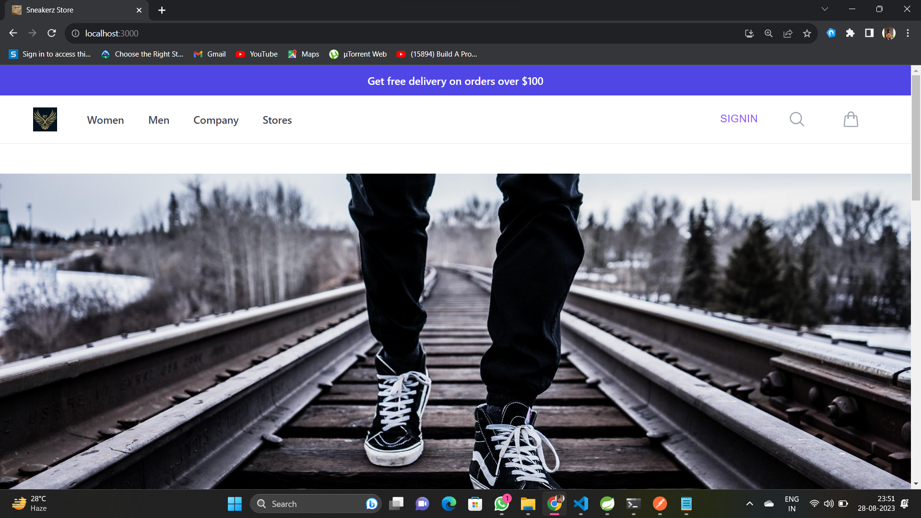
Demo

Slide 16
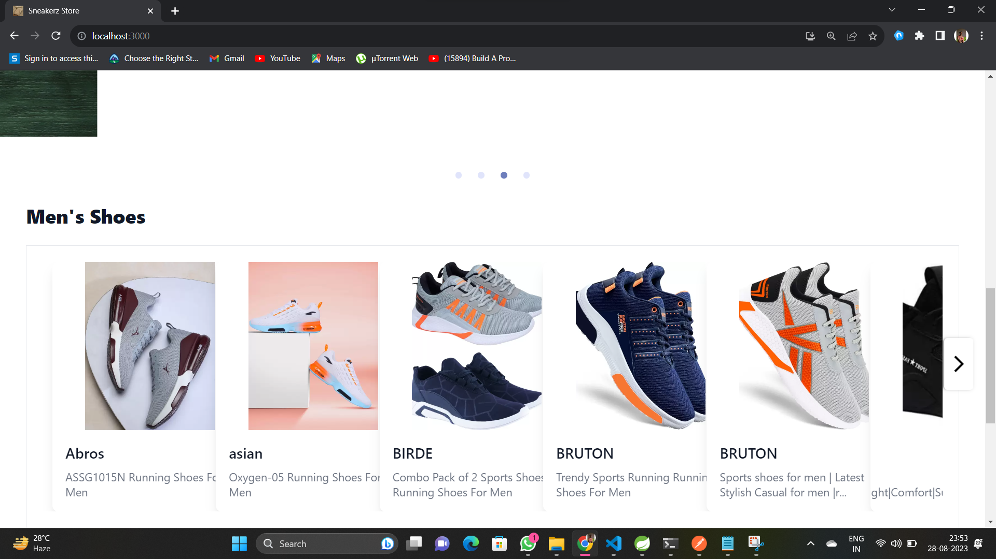

Slide 17
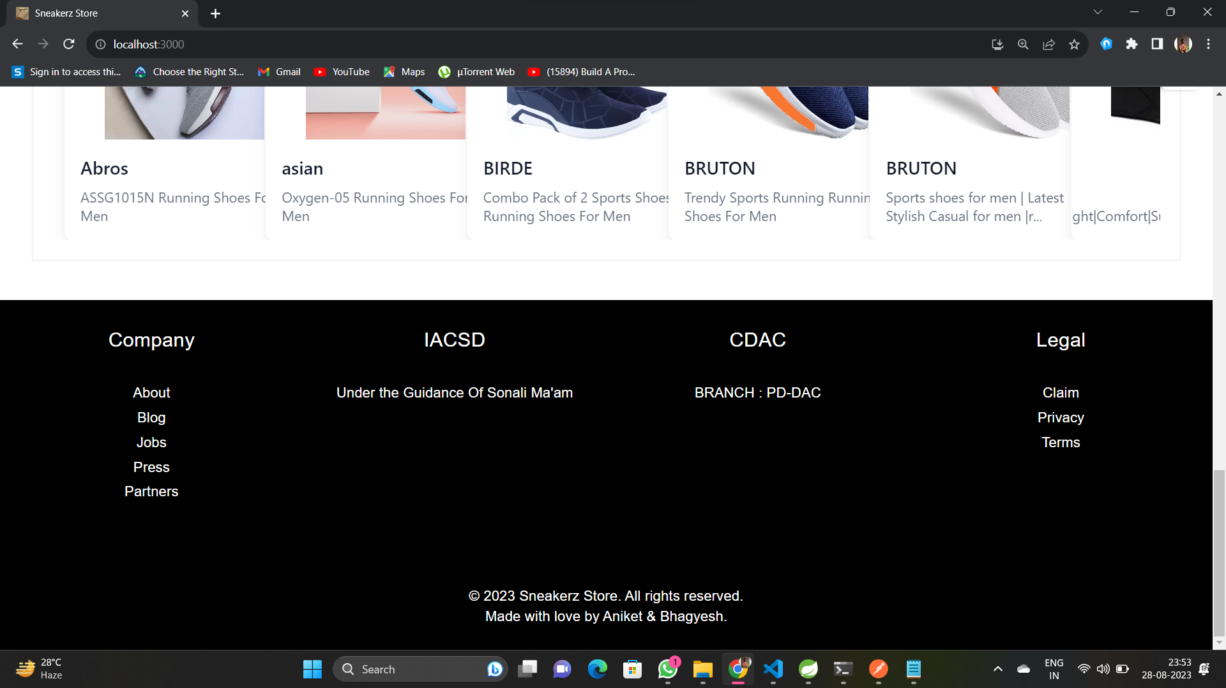

Slide 18
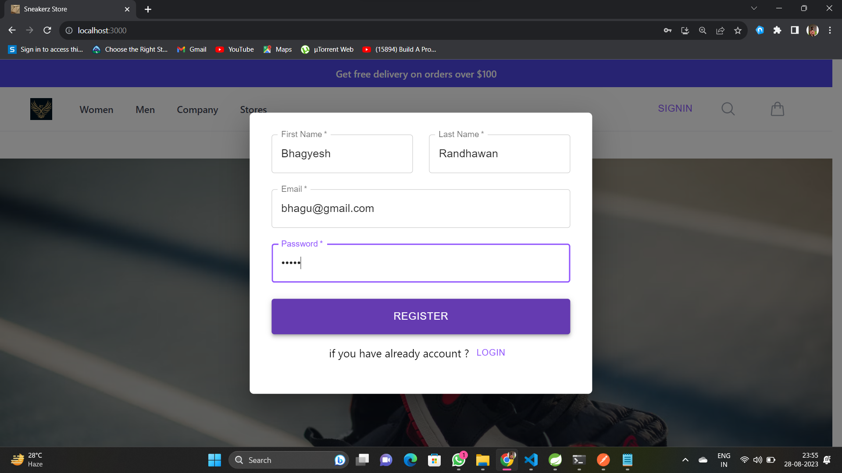

Slide 19
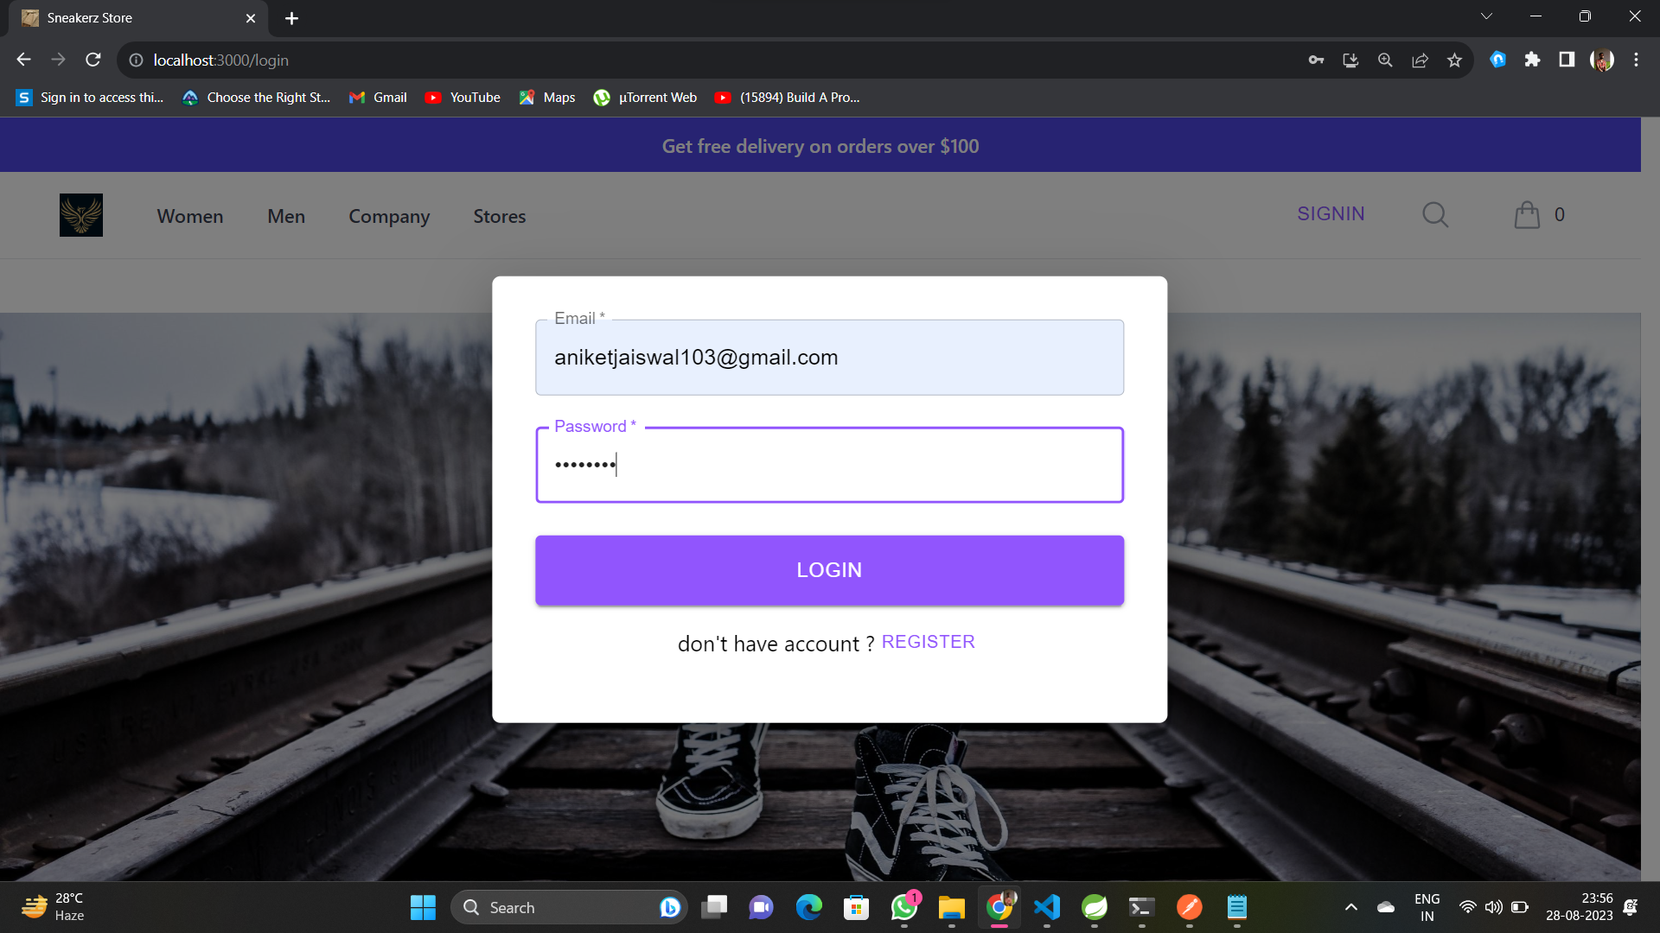

Slide 20
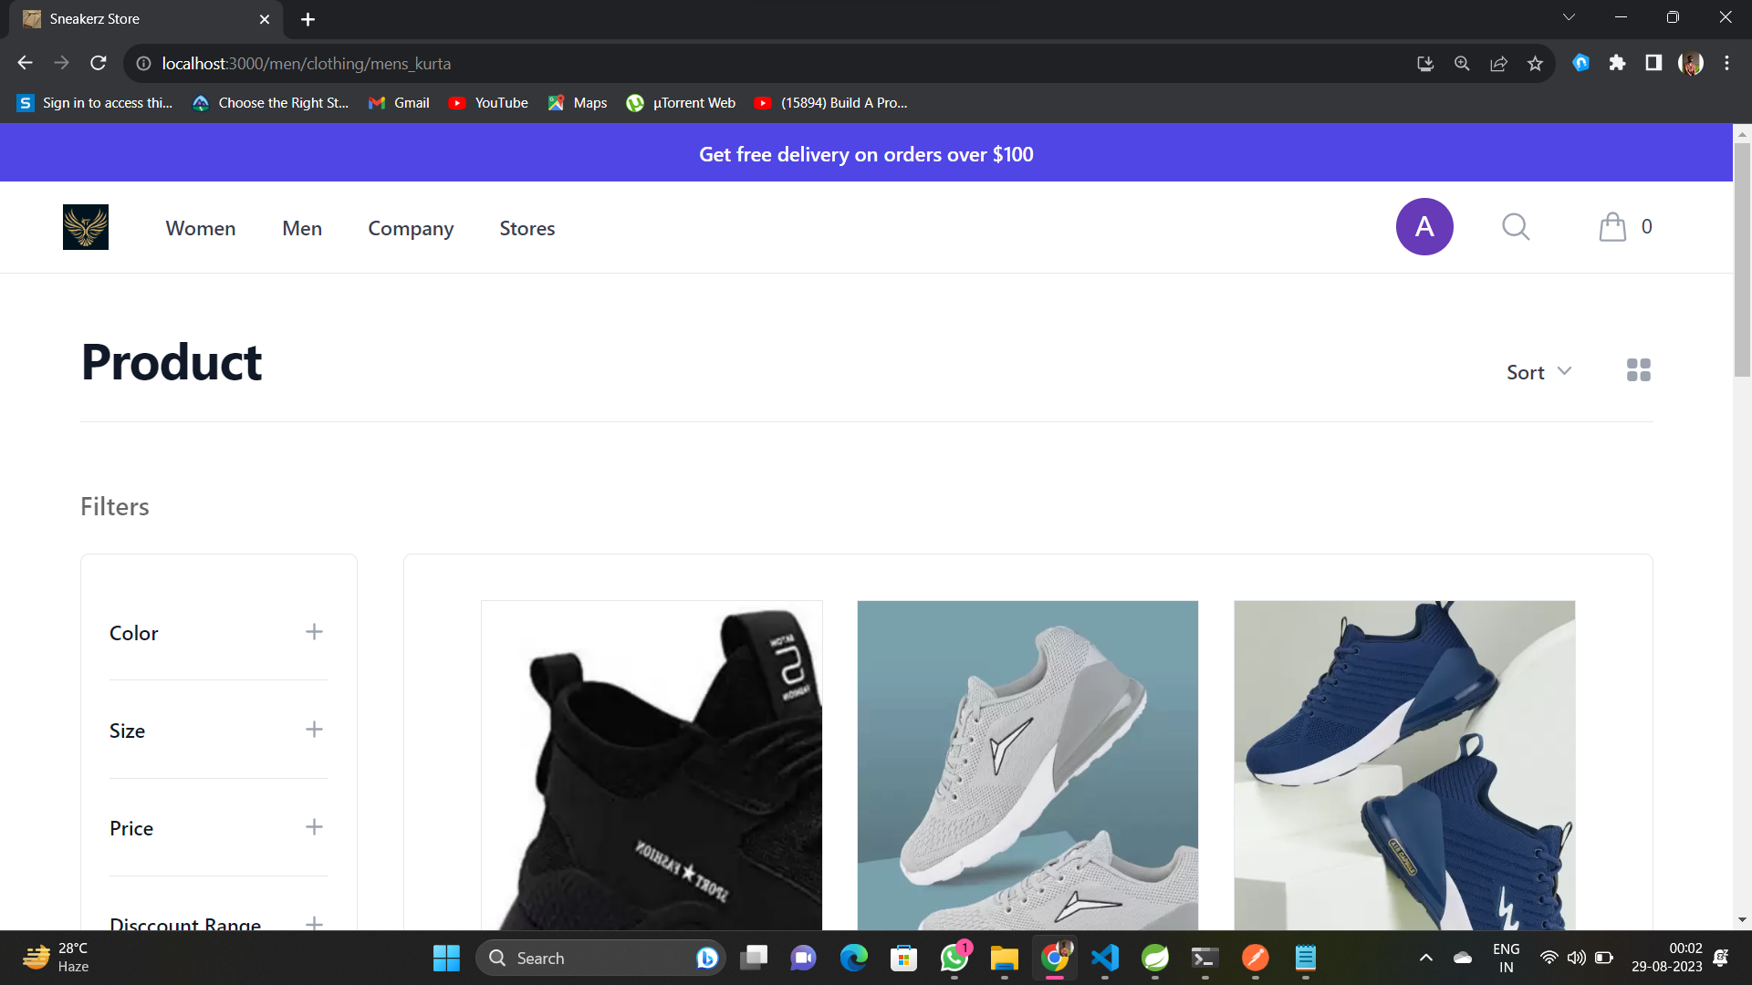

Slide 21
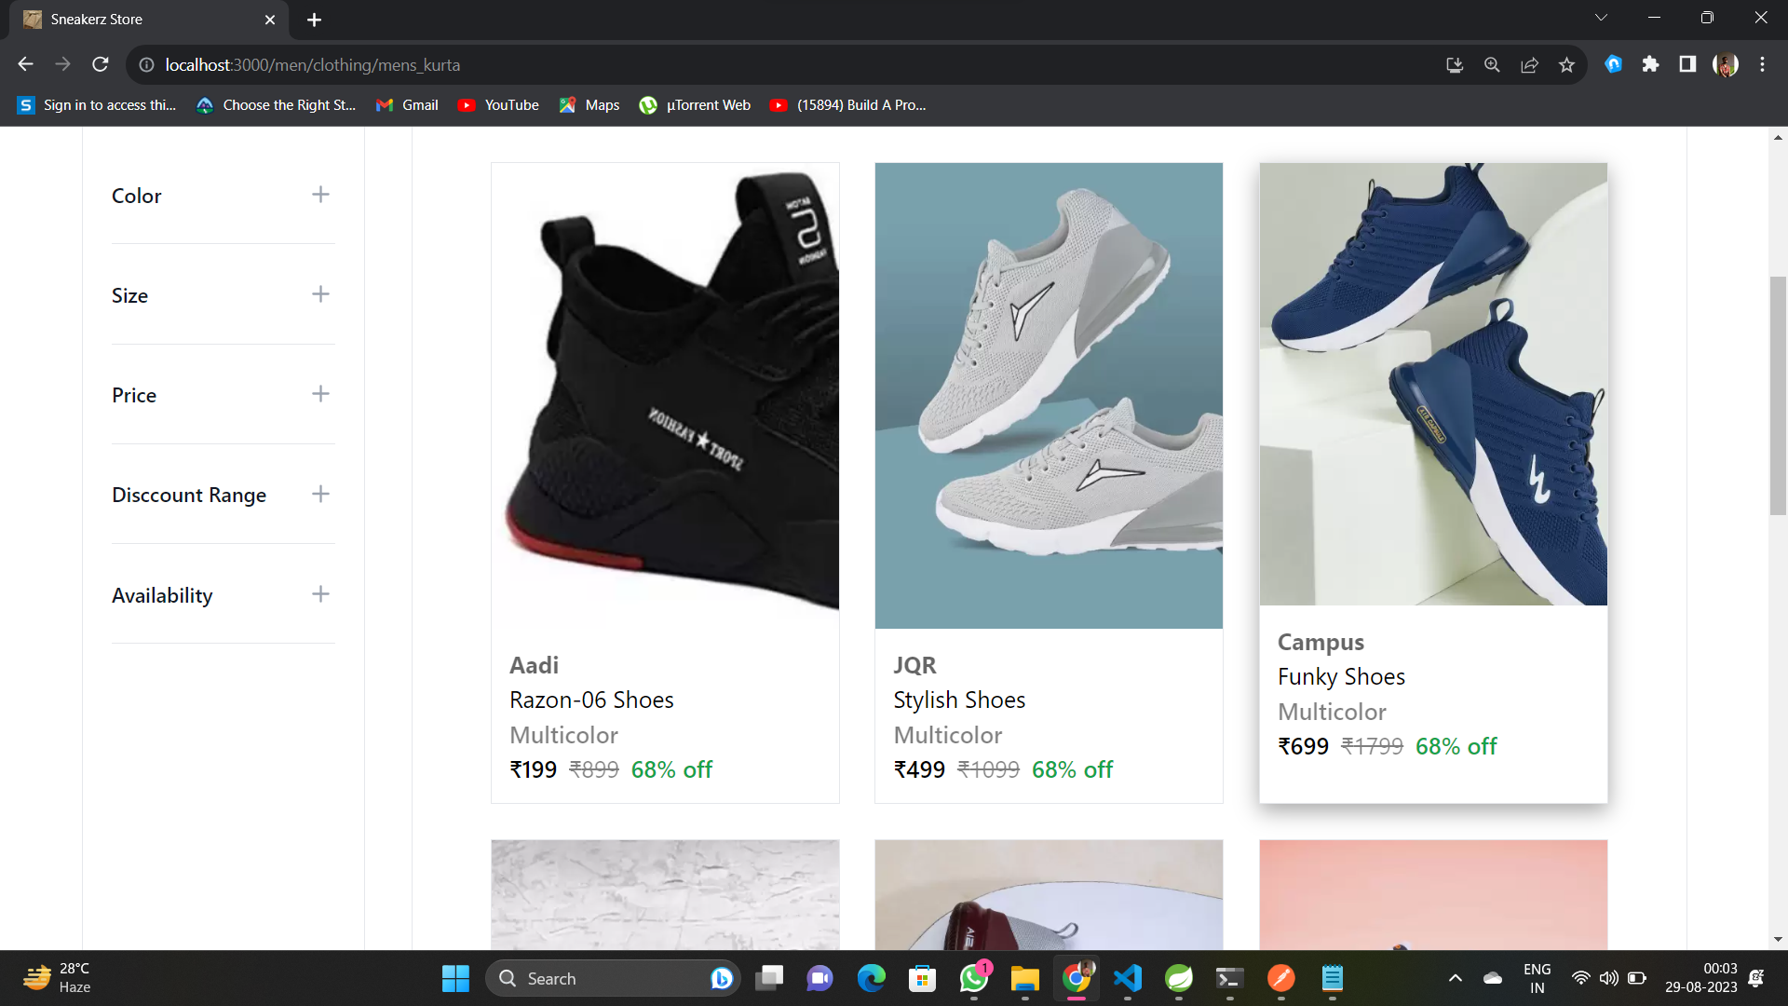

Slide 22
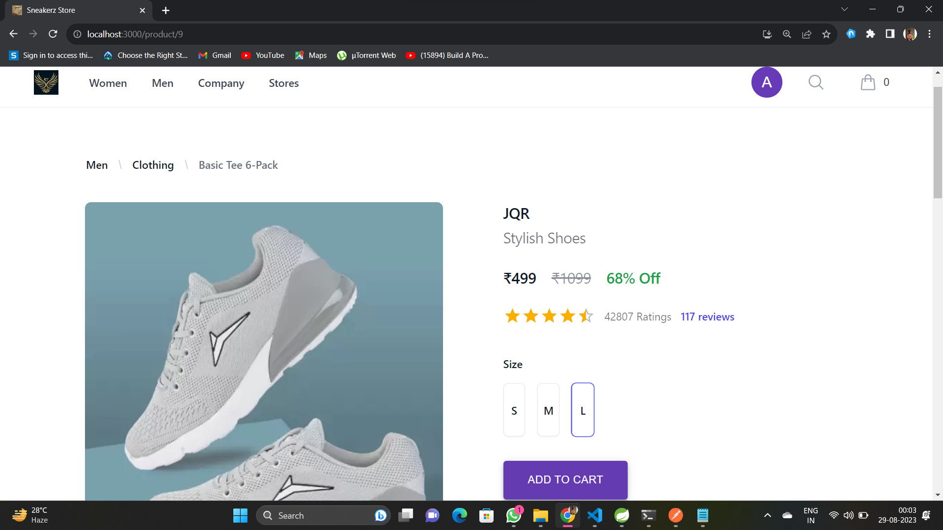

Slide 23
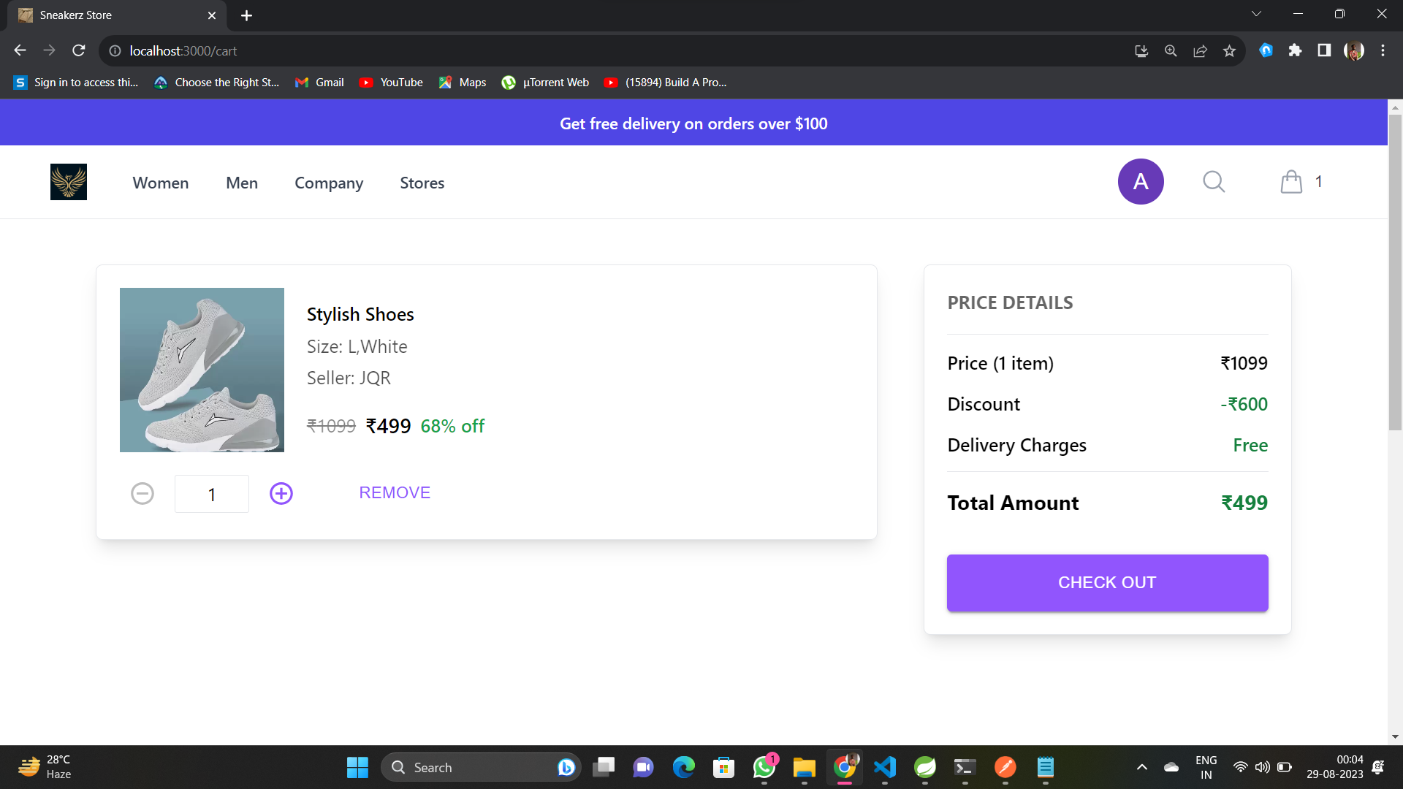

Slide 24
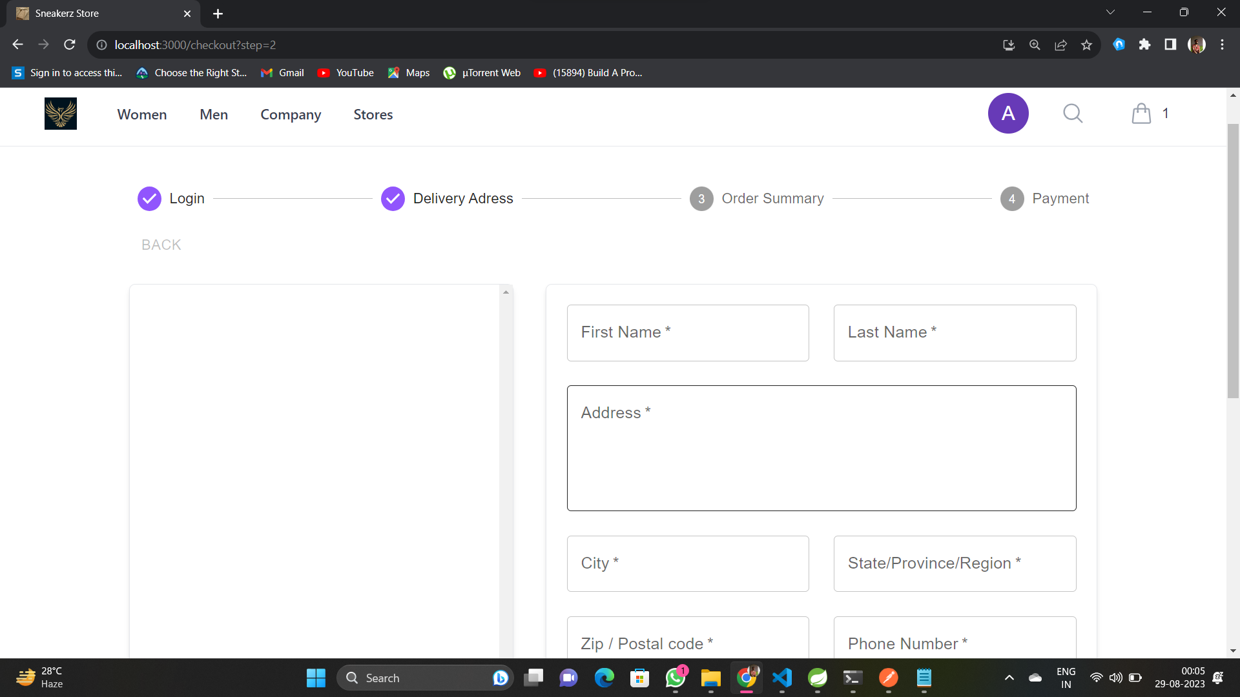

Slide 25
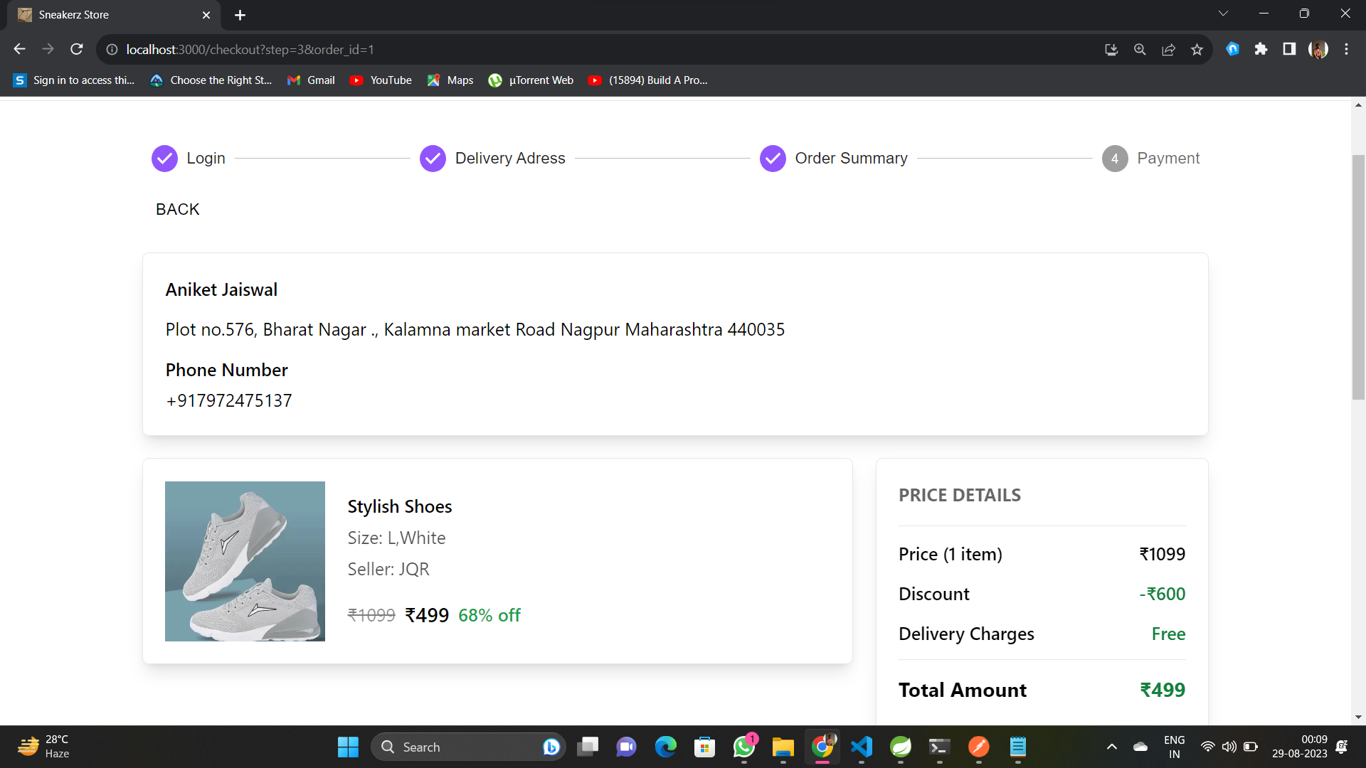

Slide 26
Thank You

